Slide 1
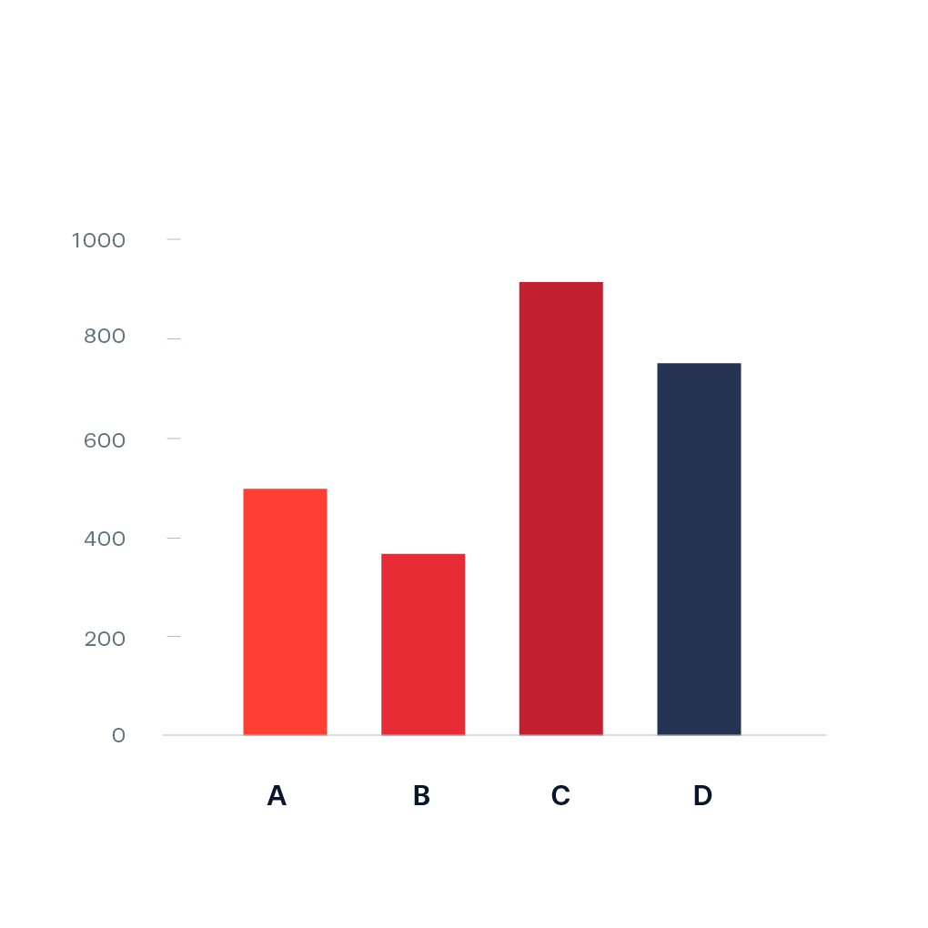
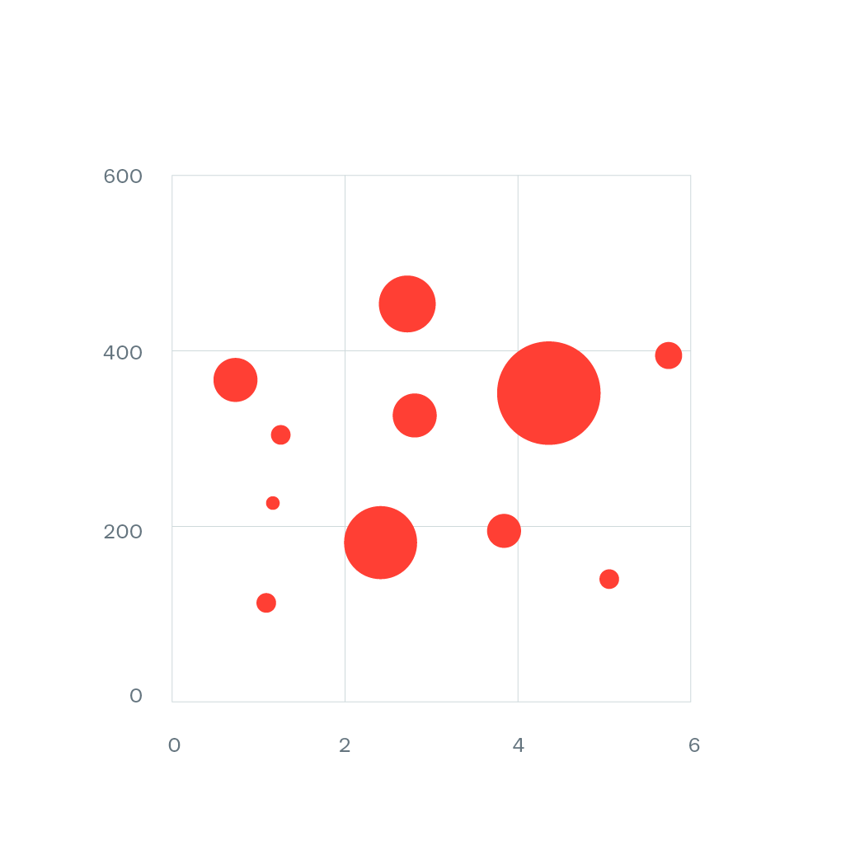
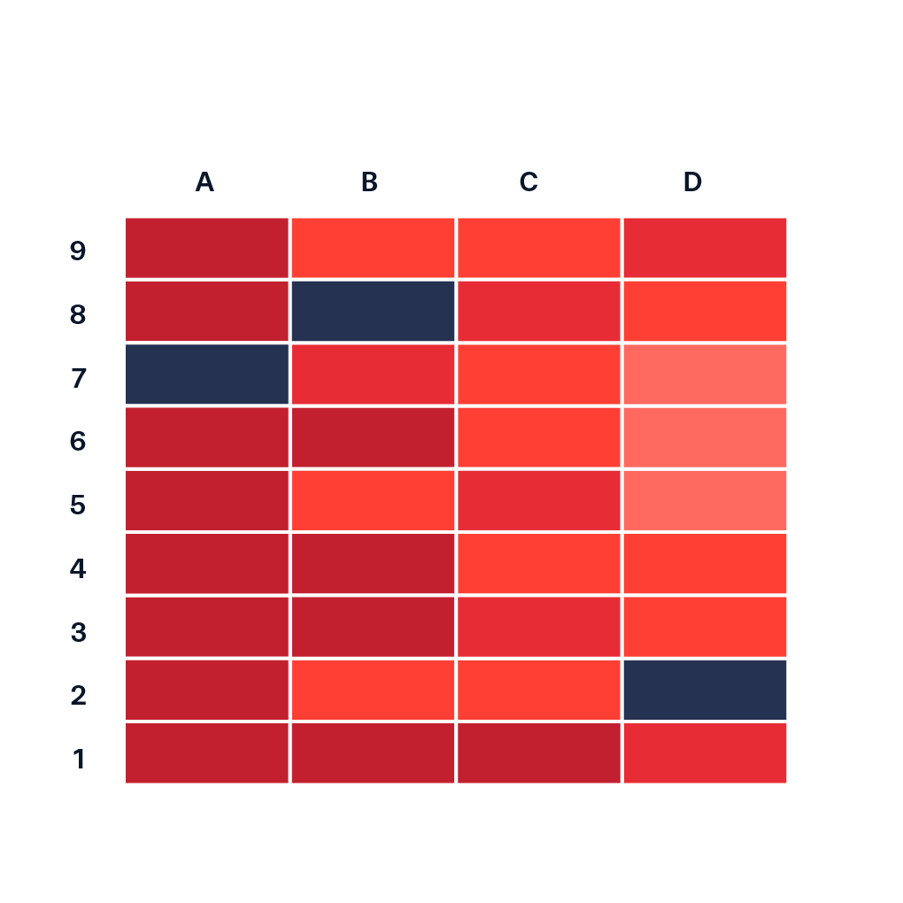
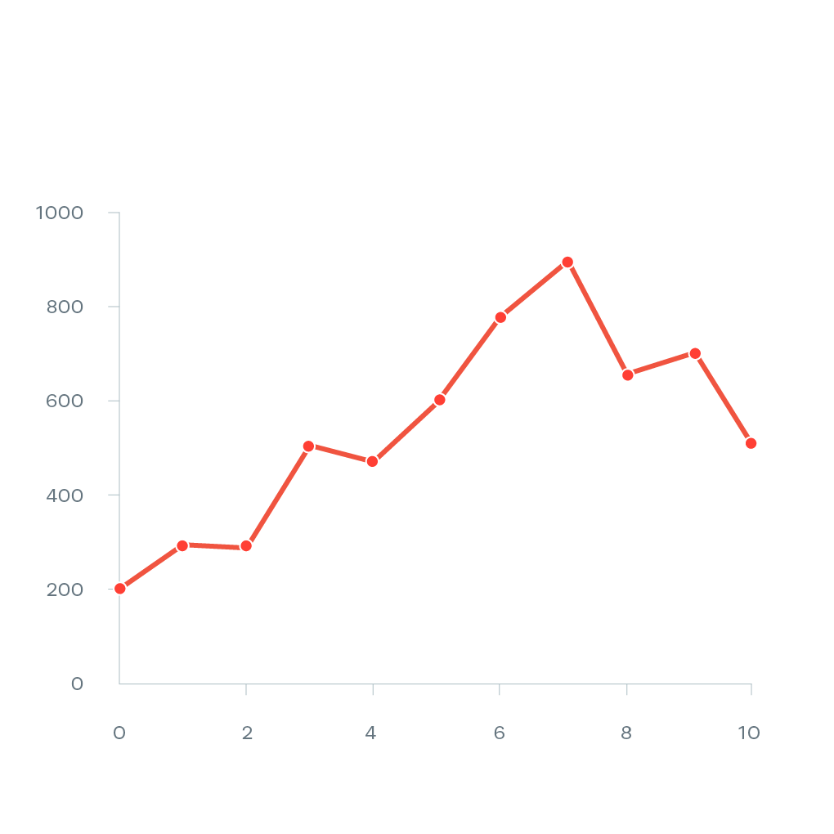
Visualizing Institutional Rankings
DS 650 - Data Visualization
Ranking 2
Notes:
Have you ever wondered how we can find the right college that suits our needs? Well, that's where the College Scorecard website comes in. We can find out about things like admission rates, graduation rates, and even about the expenses.
But here's the thing: just having all that data isn't enough. We need to figure out how to use it effectively to help people make decisions about their education.
We examined the College Scorecard data in detail and selected the most significant information. After that, we made visualizations that will be useful for students and their families to make a wise decision about their educational future.

Slide 2
Ranking 2 Group
Anurag Ramadugu - ar2697
Denil Jain - dj325
Jyothsna Kaamala - jk734
Shalini Sharma - ss4923

Slide 3
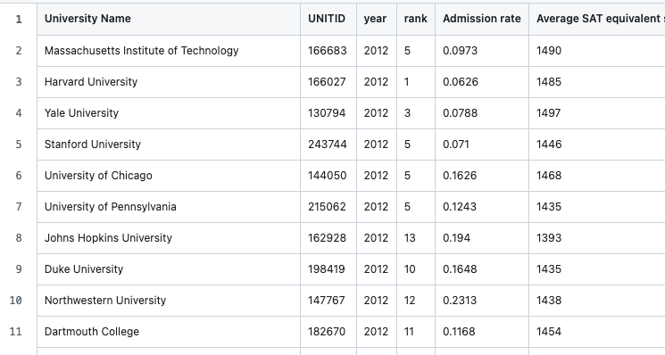
University Ranking Dataset

Slide 4
University Ranking Dataset
Key Data Points:
University Name & UNITID
Year
Rank
Admission Rate
Demographics of Enrollment
Financial Information (tuition fees, cost of living, etc.)

Slide 5
Insightful Visualizations 1
How do university rankings change with respect to Admission Rate versus the average SAT score?
Used: Scatterplot

Slide 6
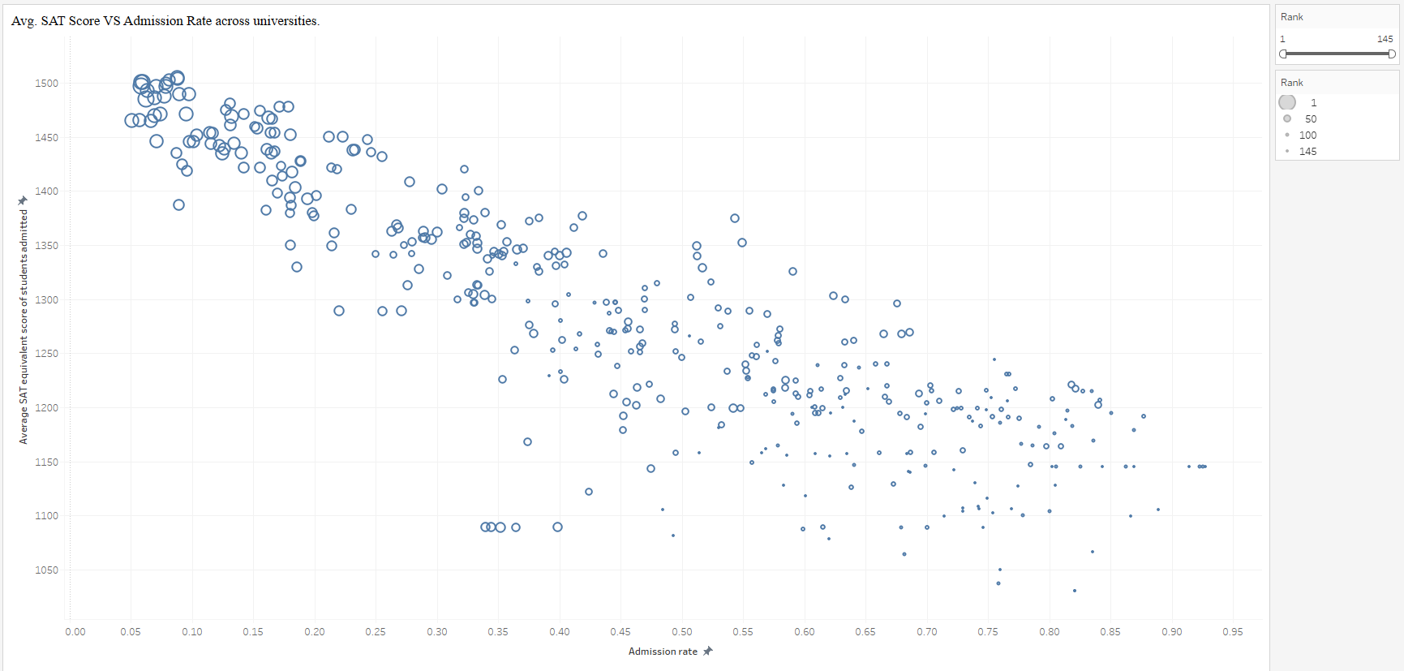
Visualization 1

Slide 7
Insightful Visualizations 2
How do the various components of university costs contribute to the overall expenses of in-state students across different ranking tiers?
Used: Side By Side Bar Chart

Slide 8
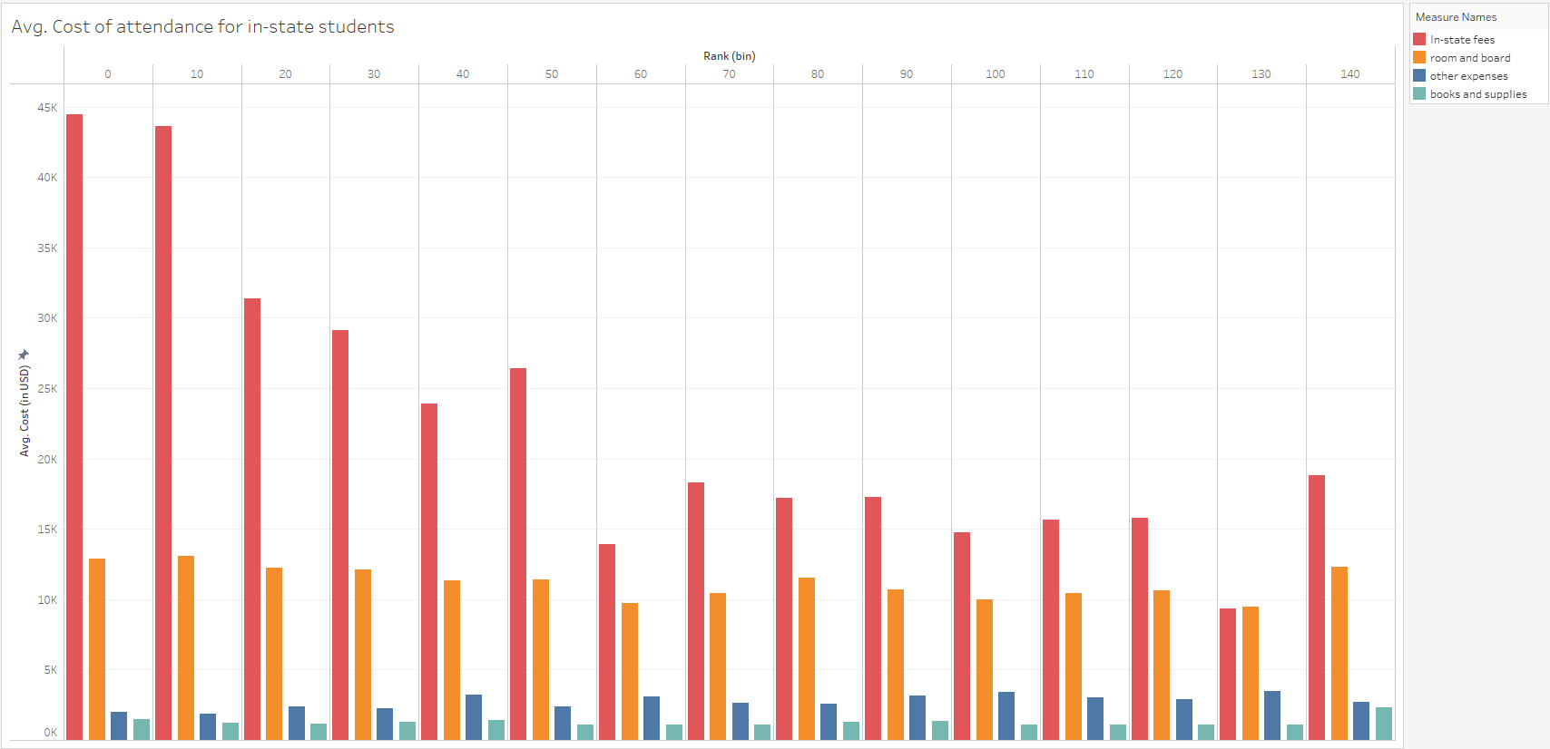
Visualization 2

Slide 9
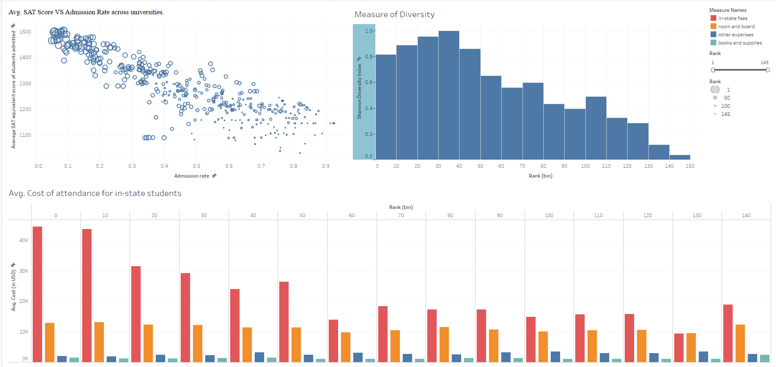
Dashboard Organization
Notes:
The Shannon Diversity Index is a mathematical formula used to measure the diversity within a community. It takes into account both the number of different categories present (like species in an ecosystem) and how evenly the individuals are distributed across those categories.
calculates the index by summing the product of the proportion of each category and the logarithm of that proportion. This calculation reflects both the variety of categories and the balance of distribution among them, resulting in a single, comprehensive measure of diversity.
Shannon Diversity index: function : (Summation of Natural Log of portion multiplied with portion)/ max(value) ; division is done for normalization it from 0 to 1.

Slide 10
Thank You!

